Slide 1
TECHNOLOGY, ENGINEERING AND DATA CONTINUING AND PROFESSIONAL EDUCATION
Courses for professionals in the Sacramento Area
Alex Lowrie: awlowrie@ucdavis.edu
John Dolan: jjdolan@ucdavis.edu

Slide 2
Sacramento Tech Jobs Landscape
Product Managers
Business Requirements
Computer Systems Analysts
1158
Information Security
Analysts
BI Analysts
UI/UX
Designer/
Developer
Web Developers
IT Project Managers
Systems Engineers/ Architects
Database Architects
Citizen Data Scientists
Application Development
Systems Development
Analytics Development
Computer
Programmers
Software QA
Computer
Network
Architects
Software
Developers,
Systems SW
Data WH
Specialists
Computer User Support Specialists
Software Developers, Applications
Support
Network & System Admins
Database
Admins
Network Support
Specialists
Key
Operations
= 100 jobs

Slide 3
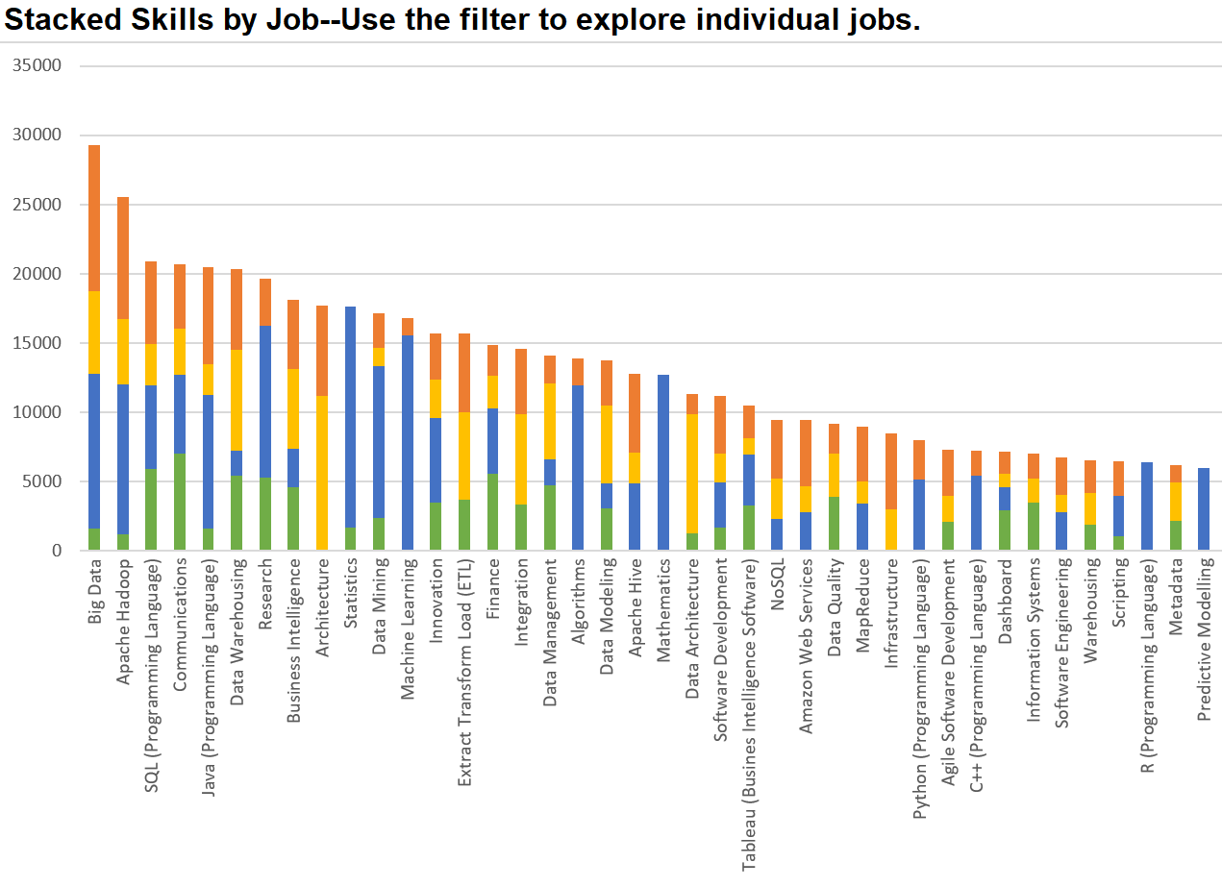
Top Skills for Four Specialist Data Roles

Slide 4
Tech Engineering Data [TED] Portfolio
Learner Is…
Tech
Data
Specializing
Blockchain / FinTech
Cloud
Machine Learning
Data Engineering/ Big Data
Career Changing
Full Stack Development
Cyber Security
Data Analytics
Web Development
Data Analytics for Insurance
Data Analytics for X
Career Enhancing
Web Design
Data Science Fundamental Skills
DevOps
Secure Programing
Data Visualization
SQL for Data Science
Key
Live
Web Development
Computational Social Science
In Development
Proposal
Concept

Slide 5
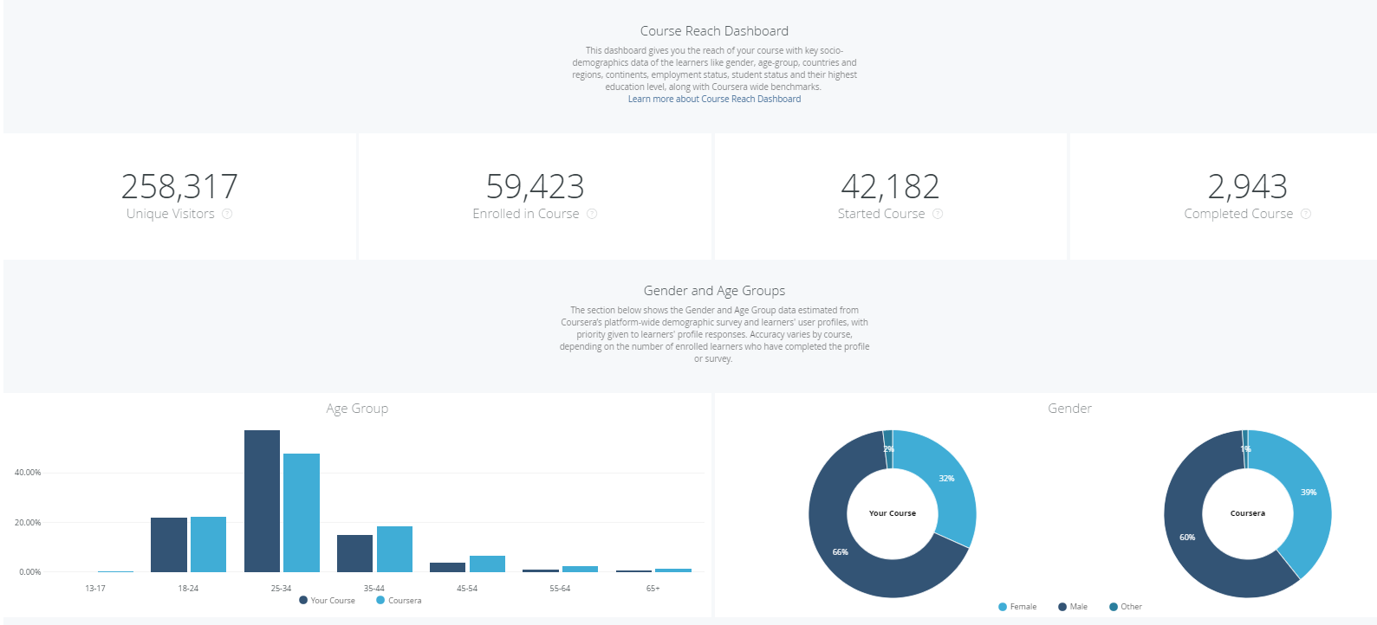
SQL for Data Science—Coursera Data

Slide 7
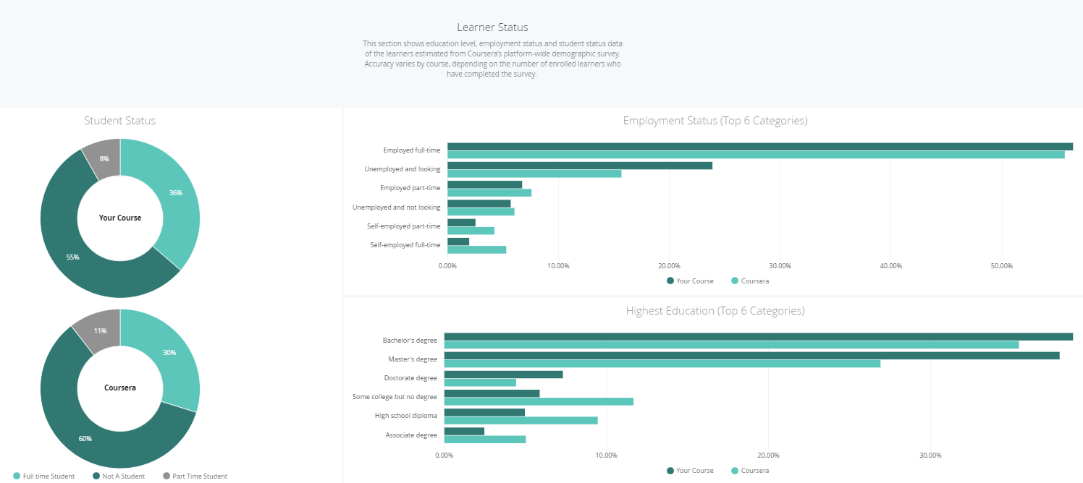

Slide 8
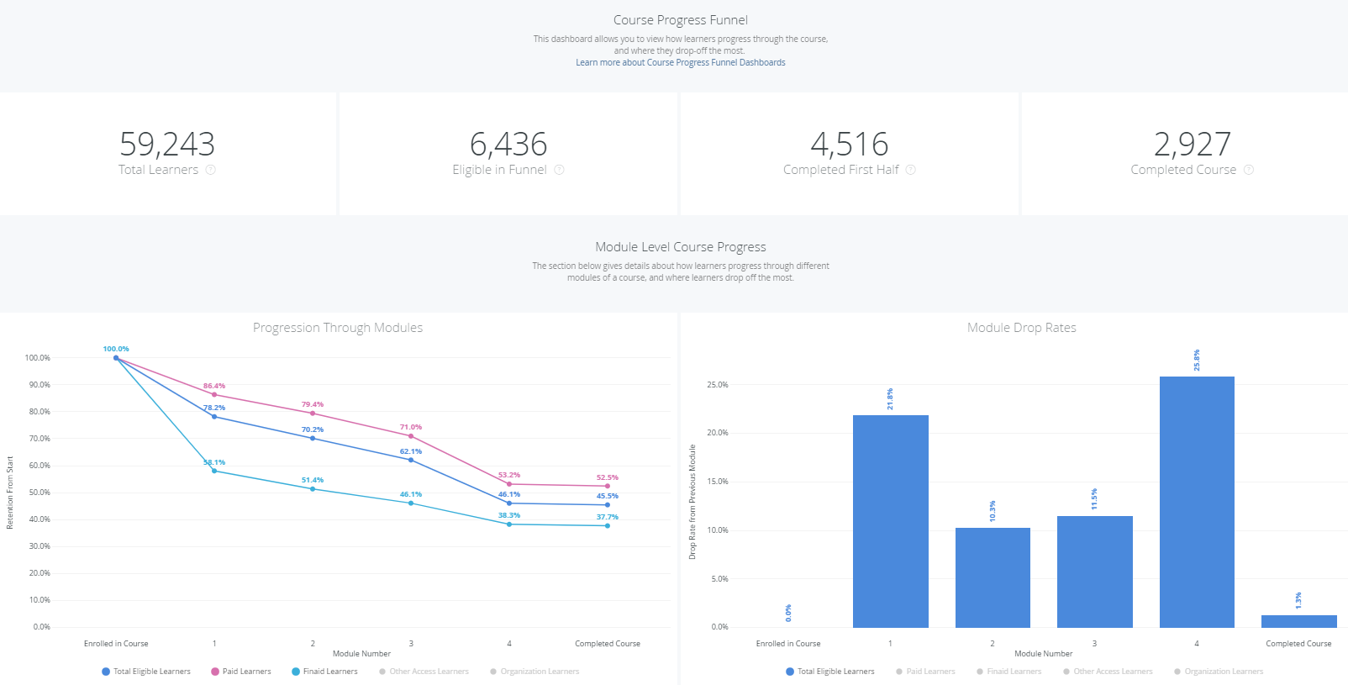

Slide 9
Thank You!
Alex Lowrie: awlowrie@ucdavis.edu
John Dolan: jjdolan@ucdavis.edu

